Slide 1
8 Parts of speech
Get your grammar on.

Slide 2
What is a part of speech?
a category to which a word is assigned based on the role it plays in a sentence

Slide 3
#1: VERBS
1. ACTION VERBS:
Show physical or mental action being performed by the subject (Ex. ~ run)
2. LINKING VERBS:
A word that links the subject with its predicate (Ex. ~ They are cold.)
HELPING VERBS:
Help the main verb (Ex. ~ will gobble)

Slide 4
#2: NOUNs
Definition: a noun is a person, place, thing, or idea
Types:
Common nouns ~ A noun that does not name a specific person, place or thing.
Ex ~ dog, boat, doctor
Proper nouns ~ A noun that DOES name a specific person, place or thing.
Ex ~ Fido, Seadog, Dr. Roz

Slide 5
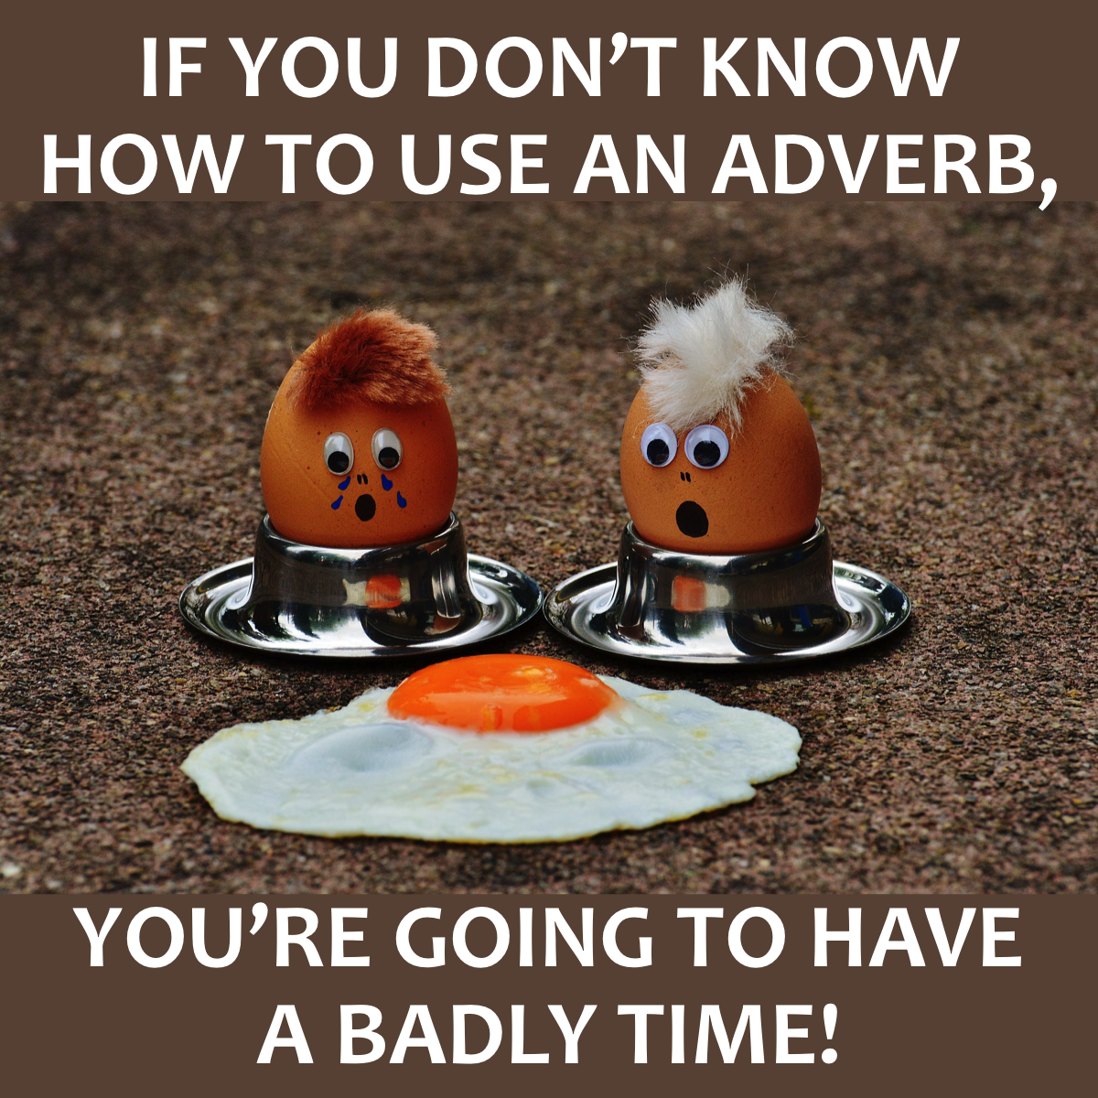
#3: Adverbs
describes a verb, adjective, or another adverb
can tell how much, how often, when, and where something is done
often ends in “-ly”
Examples: very, always, never, not, slowly

Slide 6
#4: Adjectives
Definition: a word that describes a noun or pronoun; tells what kind, how many, or which one
PRETEND YOU ARE HOLDING THIS STACK OF POST-ITS IN YOUR HAND. DESCRIBE IT – USING ADJECTIVES!

Slide 7
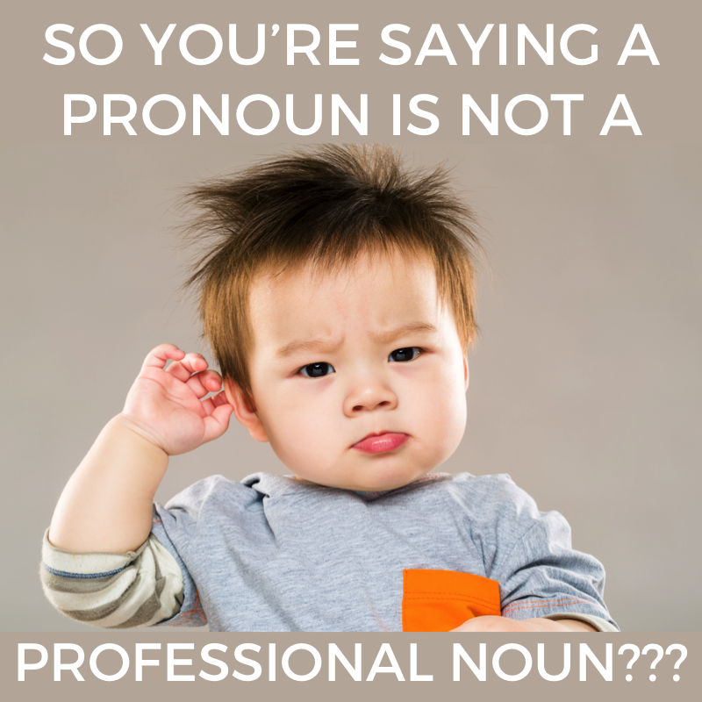
#5: Pronouns
Definition: A pronoun is a word that takes the place of a noun.
1st: I, me, mine
2nd: you, yours, yourself
3rd: he, she, they, it
There are many different
categories of pronouns.

Slide 8
#6: Conjunctions
F - for
A - and
N - nor
B - but
O - or
Y - yet
S - so
Definition: a word that joins words or word groups together
Coordinating (FANBOYS)
Correlative (not only / but also; either / or)
Subordinating (because, although, if)
Conjunctive adverbs (therefore, however)

Slide 9
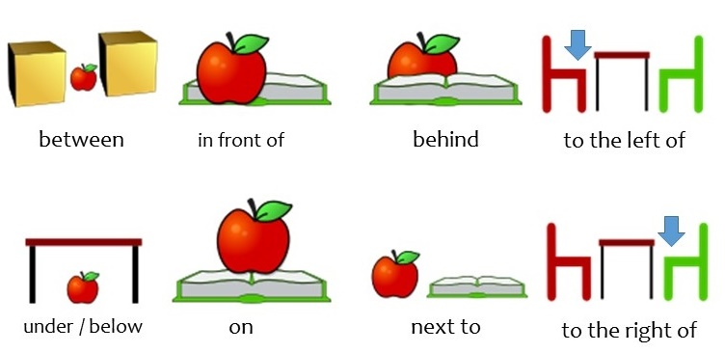
#7: Preposition
Definition: a word that shows position or direction
shows the relationship between a noun or a pronoun and some other word or element in the rest of the sentence

Slide 10
#8: Interjection
Definition: an abrupt remark, made especially as an aside or interruption; expresses strong emotions or feelings
Can be followed by a comma or an exclamation point.
Well, at least you tried.
Rats! He stole my credit card.

